Slide 1


Smart NGO Donation and Volunteer Management Platform
CSA0905 – Programming In Java
Guided by:
Dr. Sivasankar C
Presented By:
Y.Parveen(192325150)
G.Deevena(192311391)
K.Ramya(192311149)

Slide 2
Problem Background
NGOs often rely on manual records and spreadsheets, making donation and volunteer management inefficient.
Donor and volunteer information is scattered, leading to data duplication and tracking difficulties.
Lack of transparency makes it difficult for donors to monitor how their contributions are utilized.
Volunteer coordination is time-consuming, with manual task assignment and attendance tracking.
Generating reports and measuring project impact requires significant manual effort and delays decision-making.
A smart centralized platform is needed to automate operations, improve transparency, and enhance donor and volunteer engagement.

Slide 3
Problem Statement
NGOs face challenges in managing donor, volunteer, and campaign data due to manual and fragmented processes.
Studies indicate that many NGOs still depend on spreadsheets and paper-based records, resulting in errors, duplicate entries, and delays in reporting.
Current systems lack integration, making it difficult to track donations, volunteer participation, and project progress from a single platform.
Limited transparency and reporting reduce donor confidence and make it harder for NGOs to demonstrate the impact of contributions.
Volunteer coordination is inefficient, with manual scheduling, communication, and attendance tracking.
The proposed platform provides a centralized, automated solution that improves efficiency, transparency, accountability, and overall NGO performance.

Slide 4
Objectives
Primary Objective: Develop a smart web-based platform to efficiently manage NGO donations, volunteers, and impact reporting.
Automate donor management by maintaining donor profiles, tracking donations, and generating digital receipts.
Improve volunteer coordination through online registration, task assignment, event scheduling, and attendance tracking.
Provide real-time dashboards and reports to monitor donations, volunteer activities, and project impact.
Enhance transparency and accountability by enabling secure data management and clear fund utilization reports.
Project Scope: Covers donor management, volunteer coordination, and impact analytics for NGOs through a centralized digital platform.

Slide 5
Literature Survey
Year | Paper Title | Key Contribution | Limitation
2025 | Volunteer Management: A Data Mining Approach | Proposed a data-driven framework to improve volunteer retention and management using predictive analytics. | Focuses only on volunteer management; does not address donation management.
2025 | Mobile-Driven Social Impact: An Android Platform for NGO Donation and Volunteer Management | Developed a mobile application integrating donation and volunteer management. | Limited reporting and impact analytics features.
2024 | Volunteer Management in Nonprofit Organizations: A Bibliometric Analysis | Reviewed global research trends and identified best practices in volunteer management. | Literature review only; no implementation of an integrated management system.
2024 | The Effects of Volunteer Management and Personality on Quality of Life and Intention to Donate | Examined how volunteer management influences satisfaction and donation intentions. | Focuses on behavioral analysis rather than system development.
Research Gap :
Existing studies primarily focus on either donation management or volunteer management, but not both together.
Most systems lack a centralized dashboard for monitoring donations, volunteers, and project impact.
Limited support for real-time analytics, transparency, and fund utilization tracking.
The proposed project integrates donor management, volunteer coordination, and impact analytics into a single smart platform.

Slide 6
Existing System vs Proposed System
Advantages :
Centralized platform for managing donors, volunteers, and NGO operations.
Automates donation and volunteer management, reducing paperwork and manual errors.
Provides real-time analytics to improve transparency, accountability, and decision-making.
Novelty :
Integrates donor management, volunteer coordination, and impact dashboard in one platform.
Offers real-time impact tracking with transparent fund utilization reports.
Enhances donor and volunteer engagement through automated communication and task management.
Feature | Existing System | Proposed System
Donor Management | Basic donation records | Complete donor profile and donation history
Volunteer Management | Manual scheduling and tracking | Automated registration, task assignment, and attendance
Data Management | Separate/manual records | Centralized database
Reporting | Static or manual reports | Real-time dashboard with analytics
Transparency | Limited fund tracking | Transparent donation and fund utilization tracking
Notifications | Limited or unavailable | Automated email/SMS notifications

Slide 7
Requirements
Functional Requirements: Donor registration, donation management, volunteer registration, task assignment, and impact dashboard.
Non-Functional Requirements: Security, scalability, reliability, user-friendly interface, and fast response time.
Frontend: HTML, CSS, JavaScript, Bootstrap/React.
Backend: Python (Django/Flask) or PHP (Laravel).
Database: MySQL for storing donor, volunteer, and campaign data.
APIs/Tools: Payment Gateway (Razorpay/Stripe), Email/SMS Notification API, and Chart.js for analytics.

Slide 8
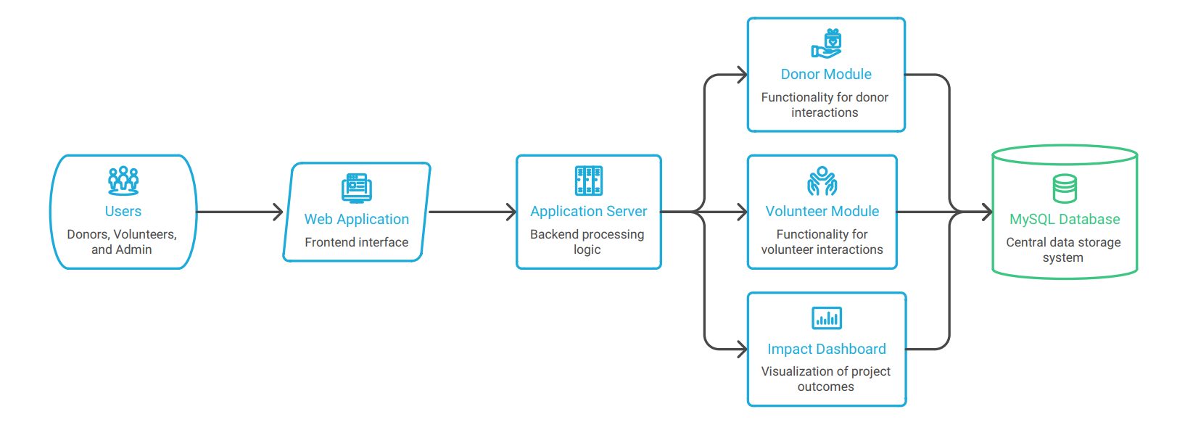
Architecture
Workflow
Users register and log in to the platform.
Donors make donations and volunteers enroll for activities.
Admin manages campaigns, donations, and volunteer assignments.
Data is stored securely in the database.
Dashboard generates real-time reports and impact analytics.
Module Description
Donor Management: Handles donor registration, donations, and receipts.
Volunteer Coordination: Manages volunteer registration, task allocation, and attendance.
Impact Dashboard: Displays donation statistics, volunteer activities, and project reports.

Slide 9
Planning
Work Breakdown Structure (WBS)
Requirement Analysis and Literature Survey
System Design (Architecture, Database, UI)
Development (Donor, Volunteer, Dashboard Modules)
Testing and Bug Fixing
Deployment, Documentation, and Presentation
Milestones
Requirements finalized
Core modules developed
Testing completed
Final deployment and project submission
Risk Analysis
Delay in development due to changing requirements.
Data security and privacy concerns.
Integration issues with payment/notification APIs.
Risk Mitigation: Regular testing, secure authentication, and backup mechanisms.
Phase | Duration
Planning & Analysis | Week 1–2
Design | Week 3
Development | Week 4–7
Testing | Week 8
Documentation & Deployment | Week 9

Slide 10
Expected Outcomes
Deliverables
Web-based NGO Donation and Volunteer Management Platform.
Donor Management, Volunteer Coordination, and Impact Dashboard modules.
Project documentation, database, and source code.
Benefits
Simplifies donation and volunteer management.
Improves transparency, accountability, and operational efficiency.
Enables real-time monitoring and reporting for better decision-making.
References (IEEE)
J. Smith and A. Brown, “Volunteer Management: A Data Mining Approach,” Voluntas, vol. 36, no. 2, pp. 245–260, 2025.
A. Restrepo et al., “Volunteer Management in Non-Profit Organizations: Experience of Huellas Foundation in Medellín, Colombia,” Administrative Sciences, vol. 15, no. 3, Art. 77, 2025.
S. Kumar and R. Patel, “Mobile-Driven Social Impact: An Android Platform for NGO Donation and Volunteer Management,” Journal of Emerging Technologies and Innovative Research (JETIR), vol. 12, no. 4, pp. 540–548, 2025.

Slide 11


